Slide 1
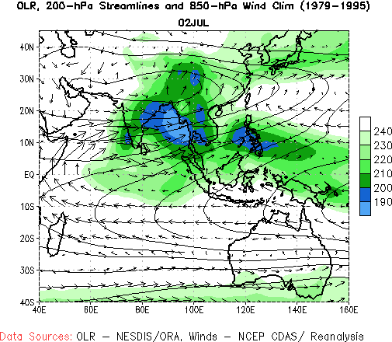
INDIA
MONSOONS

Slide 2
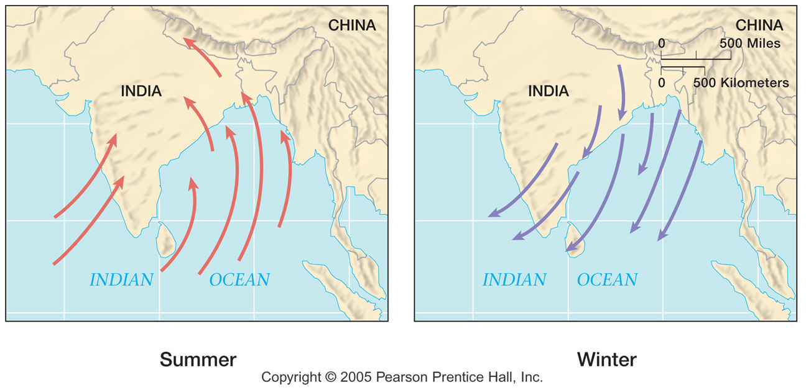
INDIA MONSOONS
India’s climate is dominated by monsoons. Monsoons are strong, often violent winds that change direction with the season. Monsoon winds blow from cold to warm regions because cold air takes up more space than warm air.
This means that monsoon winds blow from the land toward the sea in winter and from the sea toward land in the summer.

Slide 3
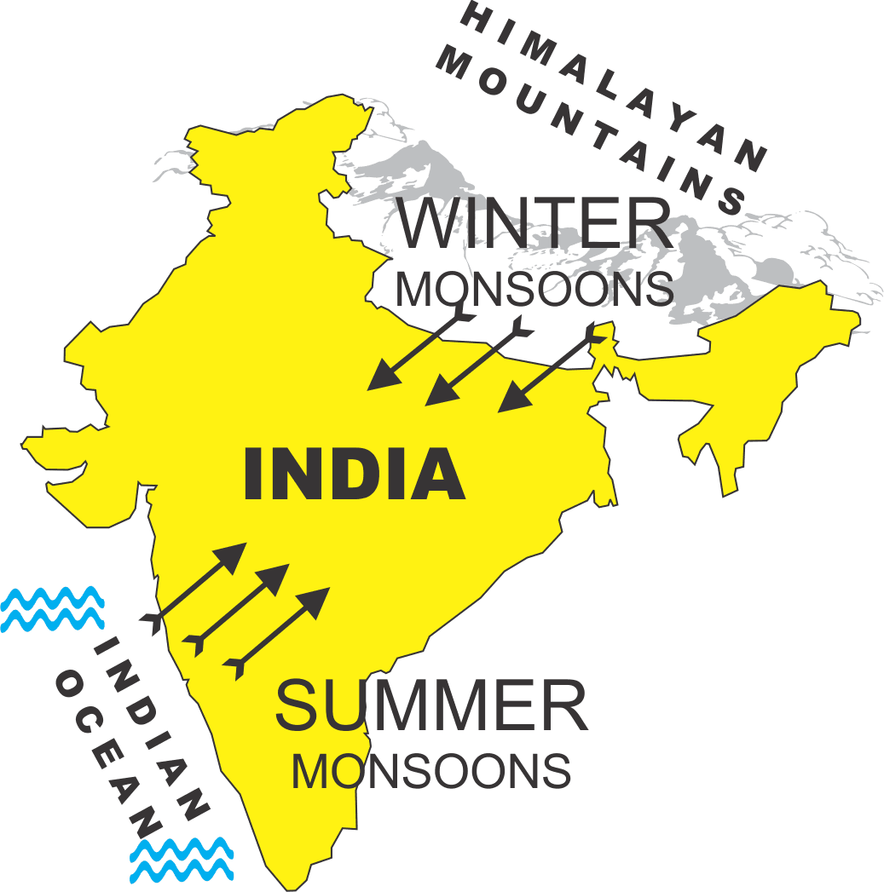
INDIA MONSOONS
India’s winters are hot and dry. The monsoon winds blow from the northeast and carry little moisture. India’s winters are hot because the Himalayas form a barrier that prevents cold air from passing onto the subcontinent.
Additionally, most of India lies between the Tropic of Cancer and the equator, so the sun’s rays shine directly on the land. The temperature can reach as high as 110ºF during the Indian winter.

Slide 4
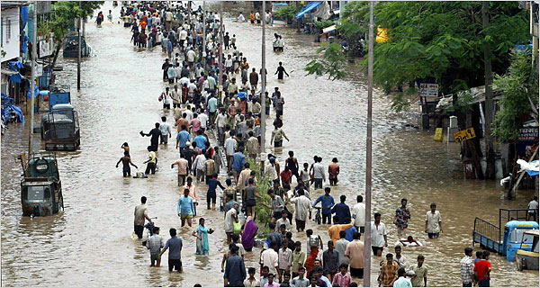
INDIA MONSOONS
The summer monsoons roar onto the subcontinent from the southwest. The winds carry moisture from the Indian Ocean and bring heavy rains from June to September. The torrential
rainstorms often cause violent landslides. Entire villages have been swept away during monsoon rains.

Slide 5
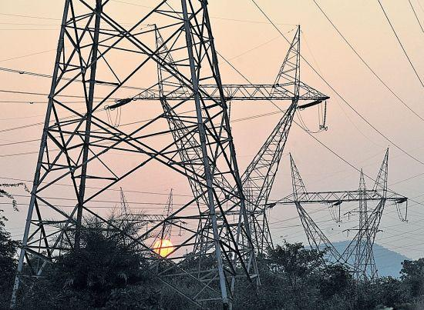
INDIA MONSOONS
Despite the potential for destruction, the summer monsoons are welcomed in India. Farmers depend on the rain to irrigate their land. Irrigated land has enough water to grow crops. Additionally, a great deal of India’s electricity is generated by water power provided by the monsoon rains.

Slide 6
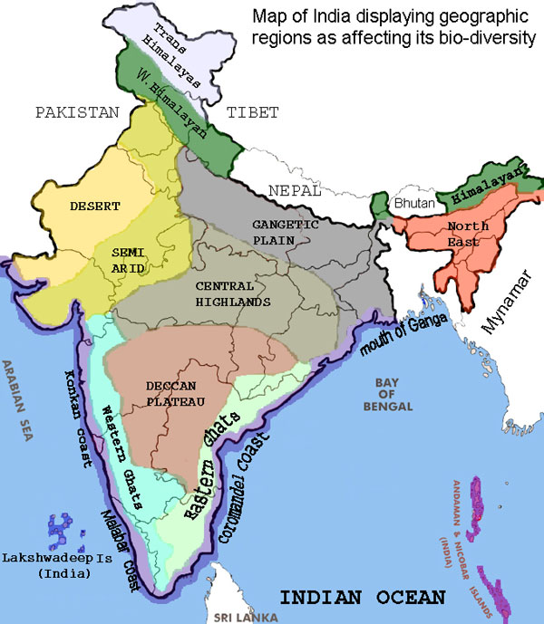
INDIA MONSOONS
Pakistan is much drier than India. The summer monsoon winds in India bring moisture from the Indian Ocean in the west, but Pakistan is north of the ocean, so it receives much less rain. The Thar Desert is on the border between India and Pakistan. Desert land recieves very little
precipitation. The Thar Desert covers more than 77,000 square miles, about the size of Nebraska.

