Slide 1
Ancient India
by Mrs. Maffit

Slide 2
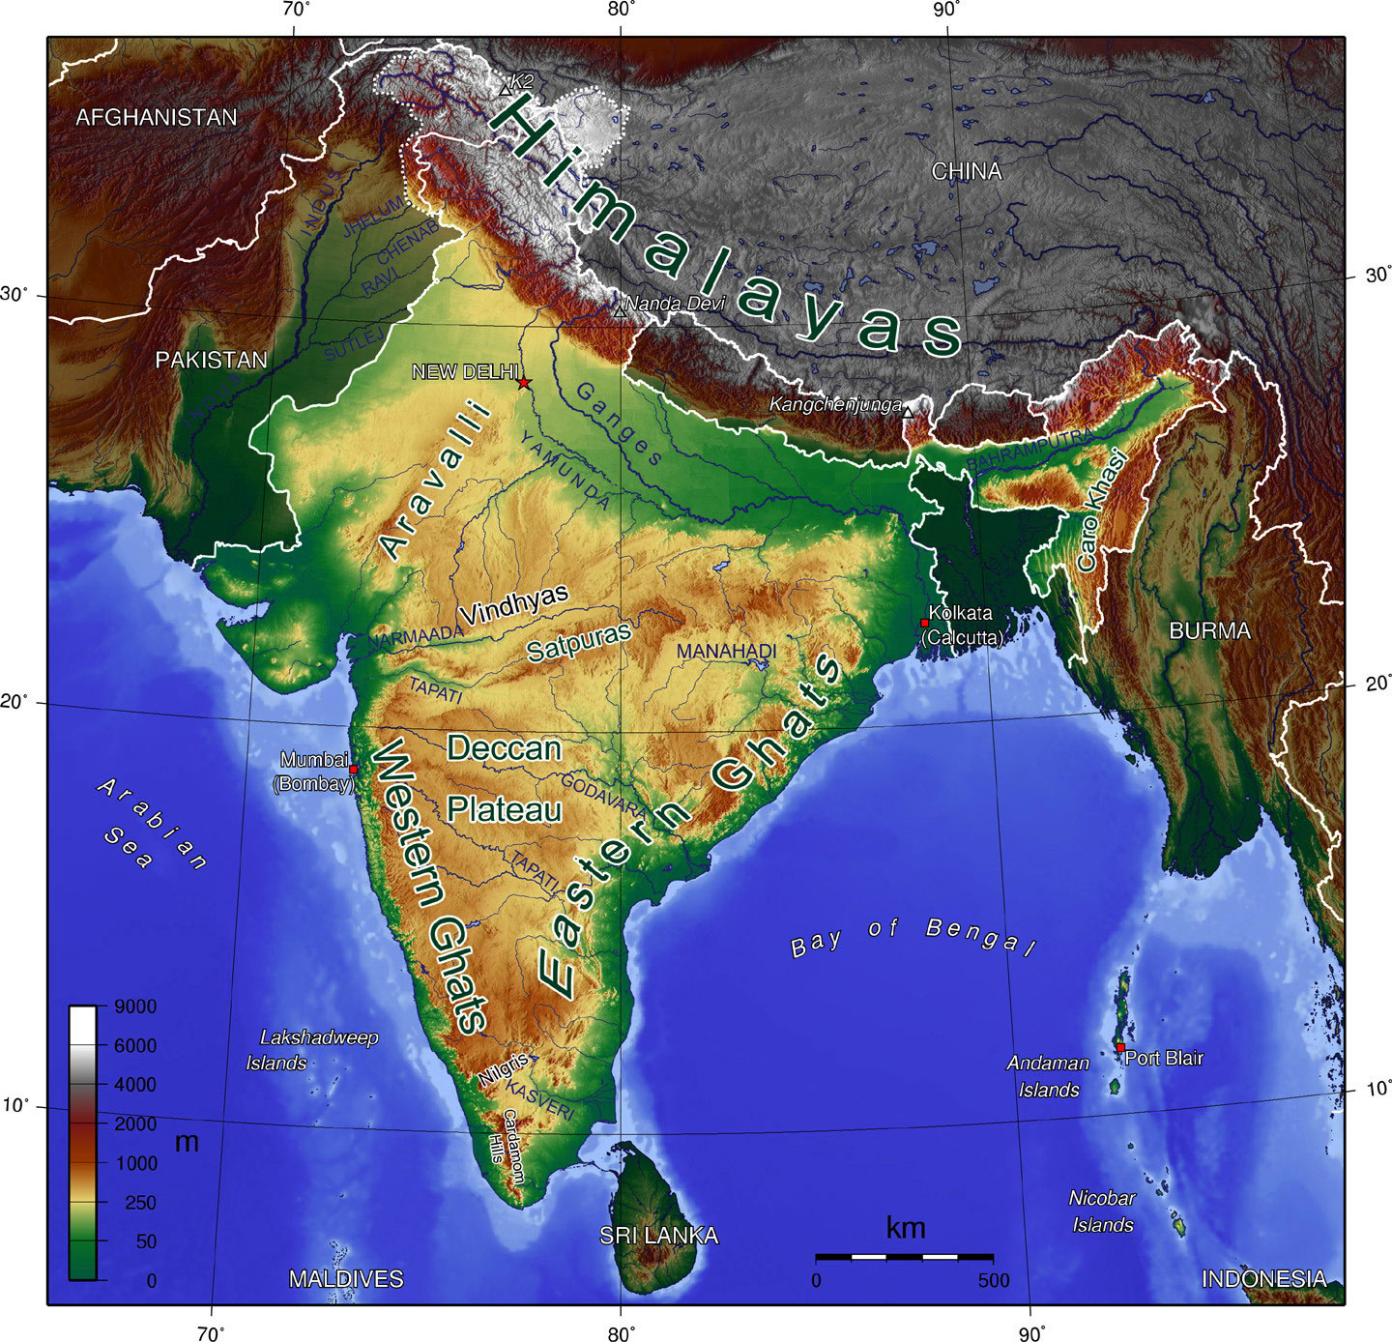
Geography of Ancient India
How did physical geography and climate influence the
development of civilization in India?
Himalayan Mountains separate India from the rest of Asia
The Indus River and Ganges River are in northern India
The Deccan Plateau is dry and hilly, but there are coastal regions and flat
plains that are good for farming.
Monsoons are strong winds that bring rain. These have both positive and negative effects. The rain is needed for farming, but too much causes flooding. Not enough results in drought.
Monsoon winds change direction with the seasons.
tropical climate - lies between Equator and Tropic of Cancer
winters reach 110 degrees
summer monsoons have torrential rains that can wipe out a village

Slide 3
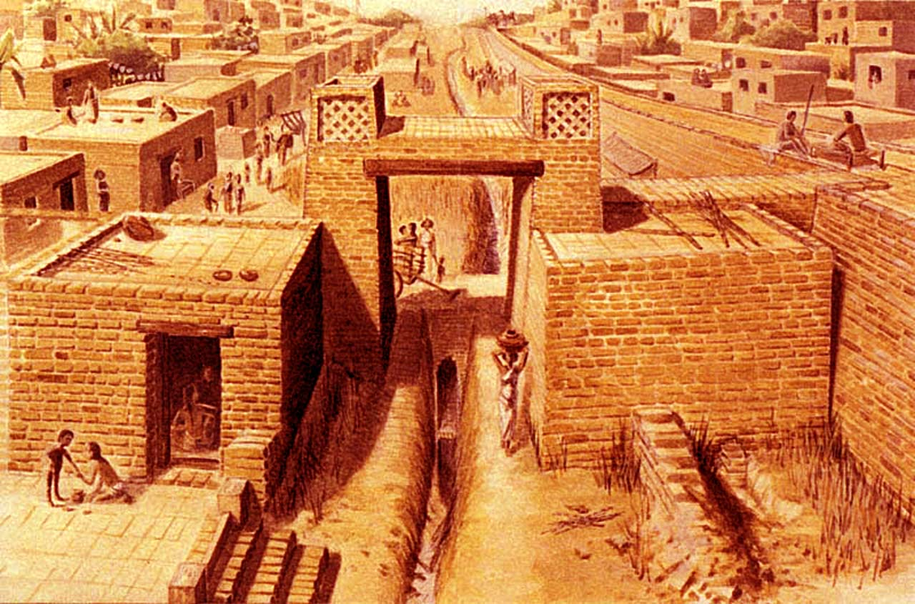
Indus River Valley Civilization
How did the people of the Indus River Valley build cities?
began in the Indus River Valley - fertile soil
lasted from 2600 BC to 1900 BC
developed in what is now modern day Pakistan
Harappa and Mohenjo-Daro were large cities - 35,000 people
cities had paved streets
houses were made of mud-baked bricks and had flat roofs, courtyards, wells for water and indoor bathrooms
most people were farmers - some people who lived in the city were merchants
Indus Valley people left NO written records
royal palace and religious temples built inside walls (fortress)
archeologists learn from studying ruins
some merchants traded with Mesopotamia

Slide 4
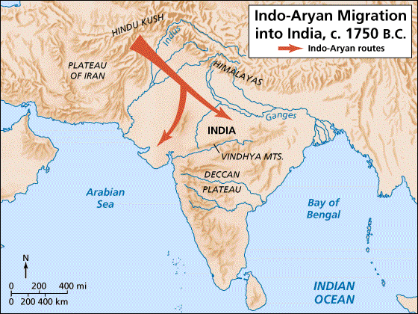
Aryans
How did the Aryans influence early India?
1900 B.C. Indus River Valley people abandoned their cities and villages because of drought, earthquakes and floods
Aryans came from Central Asia - they were a group of people who spoke similar languages
these Indo-European people were nomads in search of food for their cattle
a new civilization developed - they stopped living as nomads
they: made iron tools, developed irrigation and made the Ganges River valley good for crops
the Aryans decided cattle were sacred, so they stopped eating meat from cattle
they developed a written language called Sanskrit to record
sales and trades
they lived in groups ruled by rajas
they wrote down stories, poems, prayers and songs in sacred
books called Vedas

Slide 5
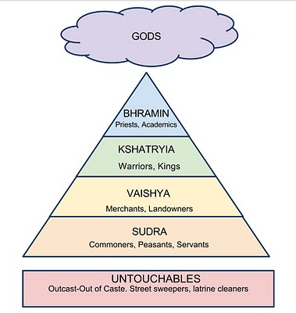
Caste System
How was society in ancient India organized?
the 4 social classes are called varnas
a person born into one caste could never change to any other.
the caste system had rules for almost every part of life -
including marriage, work and friendships
the untouchables were too low to even be part of the caste system
untouchables were thought to be unclean and had to live separate
In ancient India, family was the center of life
grandparents, parents and children lived together (extended)
elders were respected; oldest male in charge
women didn't have as many rights
males attended schools when they were older
young males taught by a guru (teacher) until older
marriages were arranged; people could NOT divorce

Slide 6
Hinduism
What are the basic beliefs of Hinduism? How did Hinduism develop?
Hinduism is one of the oldest religions in the world. It is the third largest religion in the world.
Hinduism is practiced today by 1 billion people in India.
formed when the Aryan religion (vedas) combined with others’ ideas and traditions
Hindus believed in one great spirit called Brahman
They believed all living things are part of Brahman - their soul will eventually join
They believed in reincarnation - the soul will be reborn many times, even in animals
people may rise to a better caste in the next life if they live a good life now
Karma is the result of how a person lives
Dharma is a person’s duty based on their place in society
The goal of Hindus is to reach Nirvana, a state of happiness without pain or change
Animals have souls and are sacred - therefore most Hindus are vegetarians or vegans
Do your duty to your caste - follow dharma -
create good karma - be reborn into a better life

Slide 7
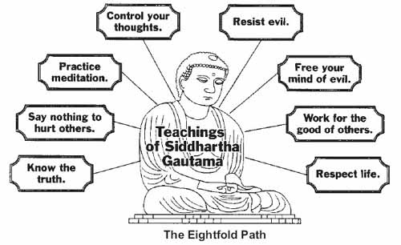
Buddhism
Why did Buddhism appeal to many people in parts of Asia?
Some Indians were unhappy with the ceremonies of Hinduism.
They wanted a simpler, more spiritual faith.
Today most Buddhist live in Southeast Asia and East Asia.
Prince Siddhartha Gautama (born in 563 B.C.) became known as the Buddha.
He gave up all his worldly possessions and became a monk,
searching for the truth about life.
He traveled the country, preaching his message and meditating (thinking deeply)
He followed some Hindu ideas and changed others.
He believed that people suffered because they cared too much about the wrong things.
He believed that seeking spiritual; truth would lead to inner peace.
Four Major Truths: 1.Life is full of suffering. 2. People suffer because they desire worldly things. 3. The way to end suffering is to stop desiring things. 4. Follow the Eightfold Path.
Buddhism spread because it welcomed people from all social classes. Buddha believed that a person’s place in life did NOT depend on the varna they were born into.

